Slide 1
Analysis of algorithms
Issues:
  correctness
  time efficiency
  space efficiency
  optimality
Approaches:
  theoretical analysis
  empirical analysis
A. Levitin “Introduction to the Design & Analysis of Algorithms,” 3rd ed., Ch. 2 ©2012 Pearson Education, Inc. Upper Saddle River, NJ. All Rights Reserved.

Slide 2
Theoretical analysis of time efficiency
Time efficiency is analyzed by determining the number of repetitions of the basic operation as a function of input size
Basic operation: the operation that contributes most towards the running time of the algorithm
T(n) ≈ c_{op}C(n)
input size
running time
execution time
for basic operation
Number of times basic operation is executed
A. Levitin “Introduction to the Design & Analysis of Algorithms,” 3rd ed., Ch. 2 ©2012 Pearson Education, Inc. Upper Saddle River, NJ. All Rights Reserved.

Slide 3
Input size and basic operation examples
Problem | Input size measure | Basic operation
Searching for key in a list of n items | Number of list’s items, i.e. n | Key comparison
Multiplication of two matrices | Matrix dimensions or total number of elements | Multiplication of two numbers
Checking primality of a given integer n | n’size = number of digits (in binary representation) | Division
Typical graph problem | #vertices and/or edges | Visiting a vertex or traversing an edge
A. Levitin “Introduction to the Design & Analysis of Algorithms,” 3rd ed., Ch. 2 ©2012 Pearson Education, Inc. Upper Saddle River, NJ. All Rights Reserved.

Slide 4
Empirical analysis of time efficiency
Select a specific (typical) sample of inputs
Use physical unit of time (e.g., milliseconds)
or
Count actual number of basic operation’s executions
Analyze the empirical data
A. Levitin “Introduction to the Design & Analysis of Algorithms,” 3rd ed., Ch. 2 ©2012 Pearson Education, Inc. Upper Saddle River, NJ. All Rights Reserved.

Slide 5
Best-case, average-case, worst-case
For some algorithms efficiency depends on form of input:
Worst case: C_{worst}(n) – maximum over inputs of size n
Best case: C_{best}(n) – minimum over inputs of size n
Average case: C_{avg}(n) – “average” over inputs of size n
  Number of times the basic operation will be executed on typical input
  NOT the average of worst and best case
  Expected number of basic operations considered as a random variable under some assumption about the probability distribution of all possible inputs
A. Levitin “Introduction to the Design & Analysis of Algorithms,” 3rd ed., Ch. 2 ©2012 Pearson Education, Inc. Upper Saddle River, NJ. All Rights Reserved.

Slide 6
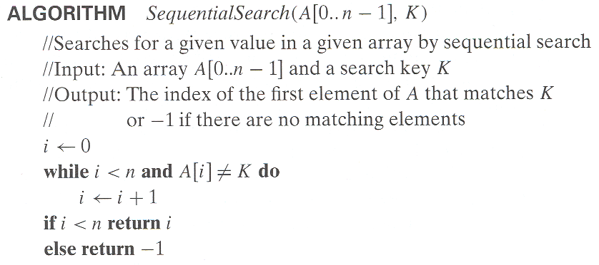
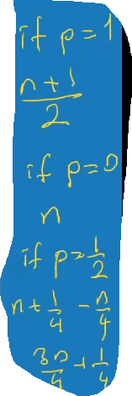
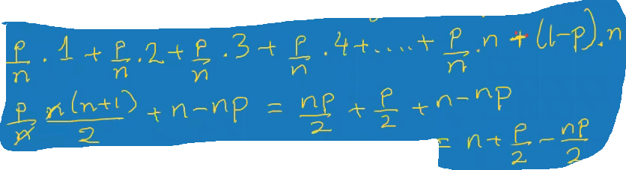
Example: Sequential search
Worst case: K does not exists or K is the last entry
Best case: K is the first element
Average case Probability of K to be found in A = p, being in any entry = n
A. Levitin “Introduction to the Design & Analysis of Algorithms,” 3rd ed., Ch. 2 ©2012 Pearson Education, Inc. Upper Saddle River, NJ. All Rights Reserved.

Slide 7
Types of formulas for basic operation’s count
Exact formula
e.g., C(n) = n(n-1)/2
Formula indicating order of growth with specific multiplicative constant
e.g., C(n) ≈ 0.5 n²
Formula indicating order of growth with unknown multiplicative constant
e.g., C(n) ≈ cn²
A. Levitin “Introduction to the Design & Analysis of Algorithms,” 3rd ed., Ch. 2 ©2012 Pearson Education, Inc. Upper Saddle River, NJ. All Rights Reserved.

Slide 8
Order of growth
Most important: Order of growth within a constant multiple as n→∞
Example:
  How much faster will algorithm run on computer that is twice as fast? 2 times faster
  How much longer does it take to solve problem of double input size? 4 times longer (C(n) ≈cn^2)
A. Levitin “Introduction to the Design & Analysis of Algorithms,” 3rd ed., Ch. 2 ©2012 Pearson Education, Inc. Upper Saddle River, NJ. All Rights Reserved.
Notes:
Example: cn²
how much faster on twice as fast computer? (2)
how much longer for 2n? (4)

Slide 9
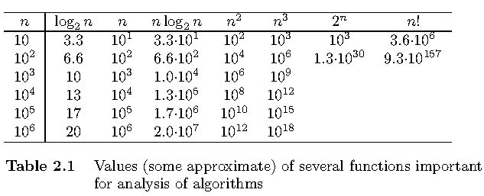
Values of some important functions as n → ∞
A. Levitin “Introduction to the Design & Analysis of Algorithms,” 3rd ed., Ch. 2 ©2012 Pearson Education, Inc. Upper Saddle River, NJ. All Rights Reserved.

Slide 10
Asymptotic order of growth
A way of comparing functions that ignores constant factors and small input sizes
O(g(n)): class of functions f(n) that grow no faster than g(n)
Θ(g(n)): class of functions f(n) that grow at same rate as g(n)
Ω(g(n)): class of functions f(n) that grow at least as fast as g(n)
A. Levitin “Introduction to the Design & Analysis of Algorithms,” 3rd ed., Ch. 2 ©2012 Pearson Education, Inc. Upper Saddle River, NJ. All Rights Reserved.

Slide 11
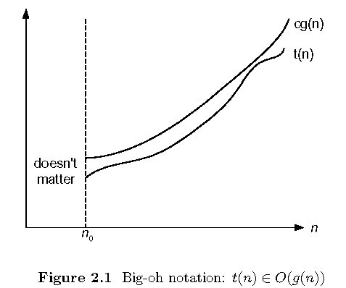
Big-oh
A. Levitin “Introduction to the Design & Analysis of Algorithms,” 3rd ed., Ch. 2 ©2012 Pearson Education, Inc. Upper Saddle River, NJ. All Rights Reserved.

Slide 12
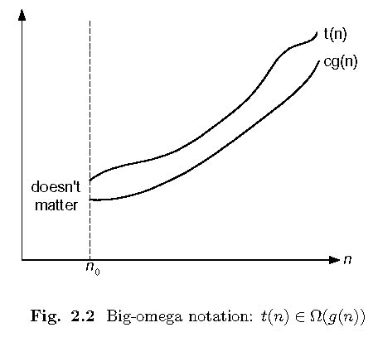
Big-omega
A. Levitin “Introduction to the Design & Analysis of Algorithms,” 3rd ed., Ch. 2 ©2012 Pearson Education, Inc. Upper Saddle River, NJ. All Rights Reserved.

Slide 13
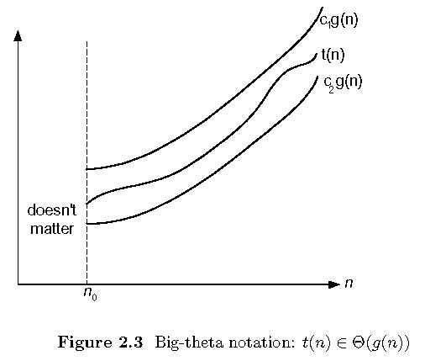
Big-theta
A. Levitin “Introduction to the Design & Analysis of Algorithms,” 3rd ed., Ch. 2 ©2012 Pearson Education, Inc. Upper Saddle River, NJ. All Rights Reserved.

Slide 14
Establishing order of growth using the definition
Definition: f(n) is in O(g(n)) if order of growth of f(n) ≤ order of growth of g(n) (within constant multiple),
i.e., there exist positive constant c and non-negative integer n₀ such that
f(n) ≤ c g(n) for every n ≥ n₀
Examples:
10n is O(n²)
5n+20 is O(n)
A. Levitin “Introduction to the Design & Analysis of Algorithms,” 3rd ed., Ch. 2 ©2012 Pearson Education, Inc. Upper Saddle River, NJ. All Rights Reserved.
Notes:
Examples:
10n is O(n²)
since 10n ≤ 10n² for n ≥ 1 or 10n ≤ n² for n ≥ 10
c n₀
5n+20 is O(10n)
since 5n+20 ≤ 10 n for n ≥ 4
c n₀

Slide 15
Some properties of asymptotic order of growth
f(n) ∈ O(f(n))
f(n) ∈ O(g(n)) iff g(n) ∈Ω(f(n))
If f (n) ∈ O(g (n)) and g(n) ∈ O(h(n)) , then f(n) ∈ O(h(n))
Note similarity with a ≤ b
If f₁(n) ∈ O(g₁(n)) and f₂(n) ∈ O(g₂(n)) , then
f₁(n) + f₂(n) ∈ O(max{g₁(n), g₂(n)})
A. Levitin “Introduction to the Design & Analysis of Algorithms,” 3rd ed., Ch. 2 ©2012 Pearson Education, Inc. Upper Saddle River, NJ. All Rights Reserved.

Slide 16
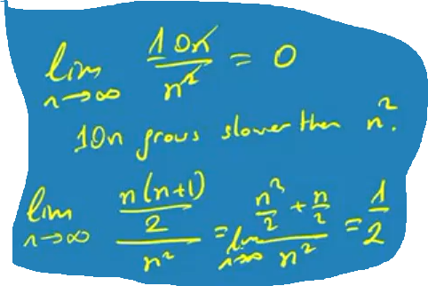

Establishing order of growth using limits
0 order of growth of T(n) < order of growth of g(n)
lim T(n)/g(n) =
c > 0 order of growth of T(n) = order of growth of g(n)
n→∞
∞ order of growth of T(n) > order of growth of g(n)
Examples:
10n vs. n²
n(n+1)/2 vs. n²
A. Levitin “Introduction to the Design & Analysis of Algorithms,” 3rd ed., Ch. 2 ©2012 Pearson Education, Inc. Upper Saddle River, NJ. All Rights Reserved.

Slide 17
L’Hôpital’s rule and Stirling’s formula
L’Hôpital’s rule: If lim_{n→∞} f(n) = lim_{n→∞} g(n) = ∞ and
the derivatives f´, g´ exist, then
Stirling’s formula: n! ≈ (2πn)^{1/2} (n/e)^{n}
f(n)
g(n)
f ´(n)
g ´(n)
lim
n→∞
=
lim
n→∞
Example: log n vs. n
Example: 2^{n} vs. n!
A. Levitin “Introduction to the Design & Analysis of Algorithms,” 3rd ed., Ch. 2 ©2012 Pearson Education, Inc. Upper Saddle River, NJ. All Rights Reserved.

Slide 18
Orders of growth of some important functions
All logarithmic functions log_{a} n belong to the same class
Θ(log n) no matter what the logarithm’s base a > 1 is
All polynomials of the same degree k belong to the same class: a_{k}n^{k} + a_{k-1}n^{k-1} + … + a₀ ∈ Θ(n^{k})
Exponential functions a^{n} have different orders of growth for different a’s
order log n < order n^{α} (α>0) < order a^{n} < order n! < order n^{n}
A. Levitin “Introduction to the Design & Analysis of Algorithms,” 3rd ed., Ch. 2 ©2012 Pearson Education, Inc. Upper Saddle River, NJ. All Rights Reserved.

Slide 19
Basic asymptotic efficiency classes
1 | constant
log n | logarithmic
n | linear
n log n | n-log-n or linearithmic
n² | quadratic
n³ | cubic
2^{n} | exponential
n! | factorial
A. Levitin “Introduction to the Design & Analysis of Algorithms,” 3rd ed., Ch. 2 ©2012 Pearson Education, Inc. Upper Saddle River, NJ. All Rights Reserved.

Slide 20
Time efficiency of nonrecursive algorithms
General Plan for Analysis
Decide on parameter n indicating input size
Identify algorithm’s basic operation
Determine worst, average, and best cases for input of size n
Set up a sum for the number of times the basic operation is executed
Simplify the sum using standard formulas and rules (see Appendix A)
A. Levitin “Introduction to the Design & Analysis of Algorithms,” 3rd ed., Ch. 2 ©2012 Pearson Education, Inc. Upper Saddle River, NJ. All Rights Reserved.

Slide 21
Useful summation formulas and rules
Σ_{l≤i≤u}1 = 1+1+ ⋯ +1 = u - l + 1
In particular, Σ_{l≤i≤u}1 = n - 1 + 1 = n ∈ Θ(n)
Σ_{1≤i≤n} i = 1+2+ ⋯ +n = n(n+1)/2 ≈ n²/2 ∈ Θ(n²)
Σ_{1≤i≤n} i² = 1²+2²+ ⋯ +n² = n(n+1)(2n+1)/6 ≈ n³/3 ∈ Θ(n³)
Σ_{0≤i≤n} a^{i} = 1 + a + ⋯ + a^{n} = (a^{n+1} - 1)/(a - 1) for any a ≠ 1
In particular, Σ_{0≤i≤n} 2^{i} = 2⁰ + 2¹ + ⋯ + 2^{n} = 2^{n+1} - 1 ∈ Θ(2^{n} )
Σ(a_{i} ± b_{i} ) = Σa_{i} ± Σb_{i} Σca_{i} = cΣa_{i} Σ_{l≤i≤u}a_{i} = Σ_{l≤i≤m}a_{i} + Σ_{m+1≤i≤u}a_{i}
A. Levitin “Introduction to the Design & Analysis of Algorithms,” 3rd ed., Ch. 2 ©2012 Pearson Education, Inc. Upper Saddle River, NJ. All Rights Reserved.

Slide 22
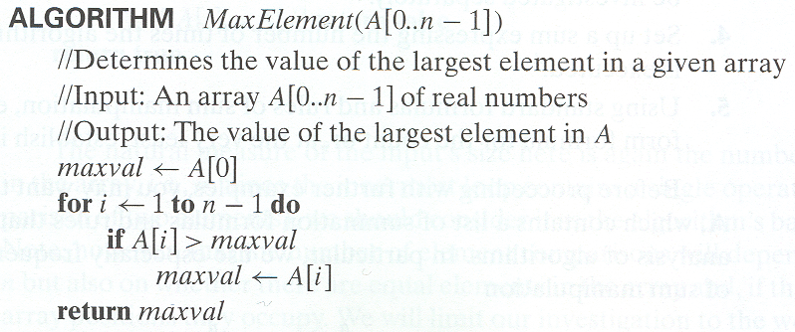
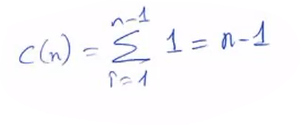

Example 1: Maximum element
A. Levitin “Introduction to the Design & Analysis of Algorithms,” 3rd ed., Ch. 2 ©2012 Pearson Education, Inc. Upper Saddle River, NJ. All Rights Reserved.

Slide 23
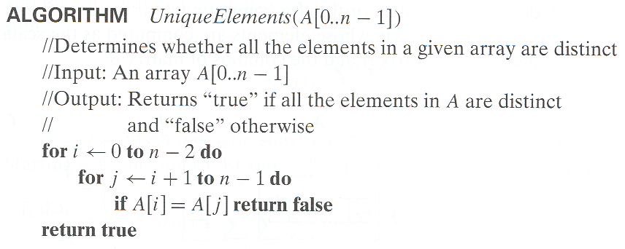
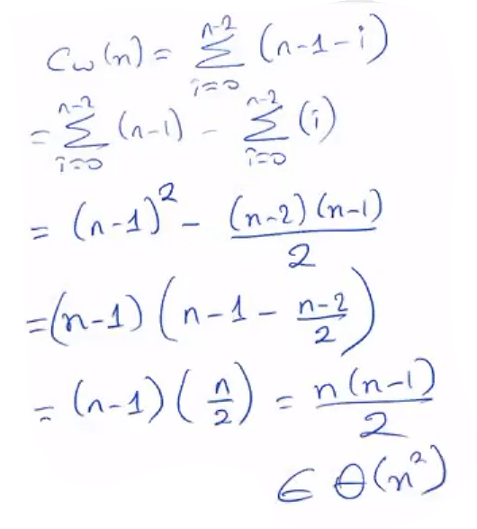

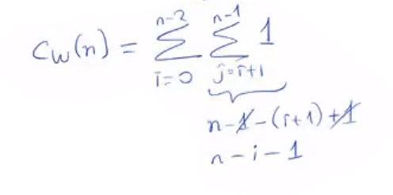

Example 2: Element uniqueness problem
A. Levitin “Introduction to the Design & Analysis of Algorithms,” 3rd ed., Ch. 2 ©2012 Pearson Education, Inc. Upper Saddle River, NJ. All Rights Reserved.

Slide 24
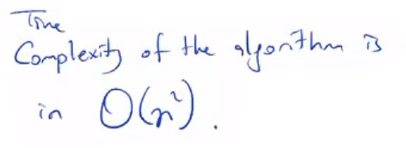
Example 2: Element uniqueness problem
A. Levitin “Introduction to the Design & Analysis of Algorithms,” 3rd ed., Ch. 2 ©2012 Pearson Education, Inc. Upper Saddle River, NJ. All Rights Reserved.

Slide 25
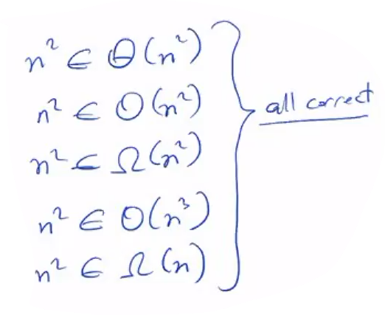
A. Levitin “Introduction to the Design & Analysis of Algorithms,” 3rd ed., Ch. 2 ©2012 Pearson Education, Inc. Upper Saddle River, NJ. All Rights Reserved.

Slide 26
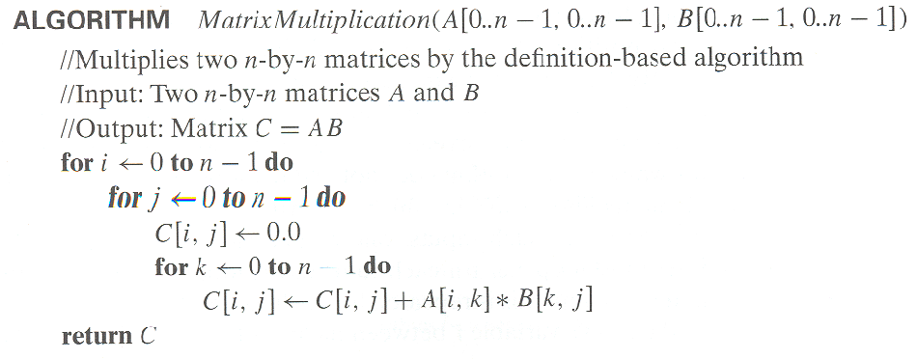
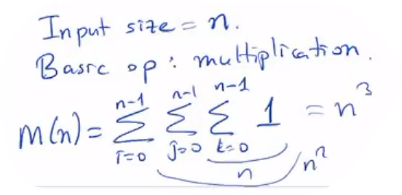
Example 3: Matrix multiplication
A. Levitin “Introduction to the Design & Analysis of Algorithms,” 3rd ed., Ch. 2 ©2012 Pearson Education, Inc. Upper Saddle River, NJ. All Rights Reserved.

Slide 27
Example 4: Gaussian elimination
Algorithm GaussianElimination(A[0..n-1,0..n])
//Implements Gaussian elimination of an n-by-(n+1) matrix A
for i ← 0 to n - 2 do
for j ← i + 1 to n - 1 do
for k ← i to n do
A[j,k] ← A[j,k] - A[i,k] ∗ A[j,i] / A[i,i]
Find the efficiency class and a constant factor improvement.
A. Levitin “Introduction to the Design & Analysis of Algorithms,” 3rd ed., Ch. 2 ©2012 Pearson Education, Inc. Upper Saddle River, NJ. All Rights Reserved.

Slide 28
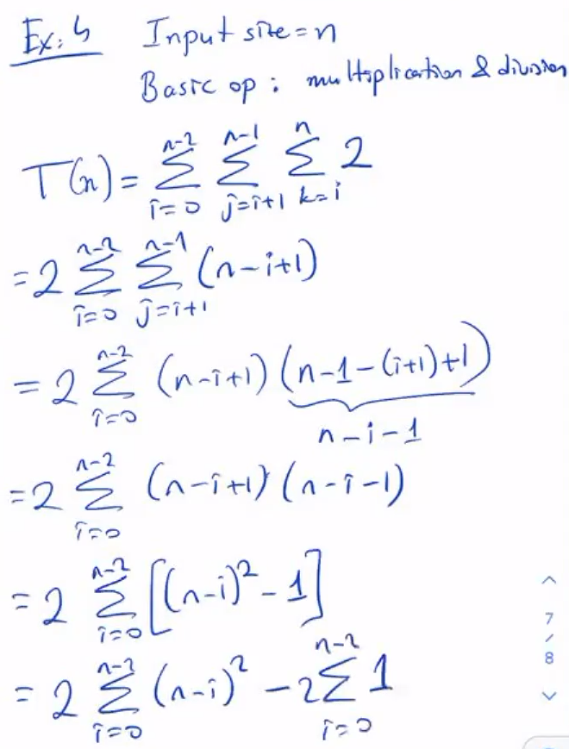
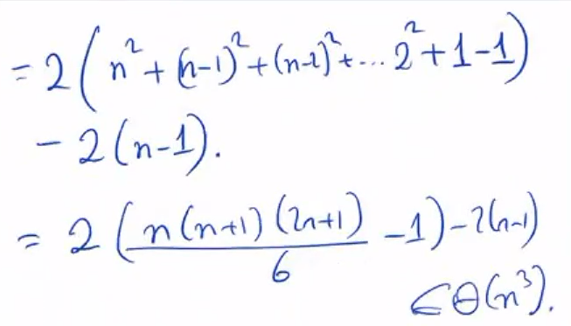
Example 4: Gaussian elimination
A. Levitin “Introduction to the Design & Analysis of Algorithms,” 3rd ed., Ch. 2 ©2012 Pearson Education, Inc. Upper Saddle River, NJ. All Rights Reserved.

Slide 29
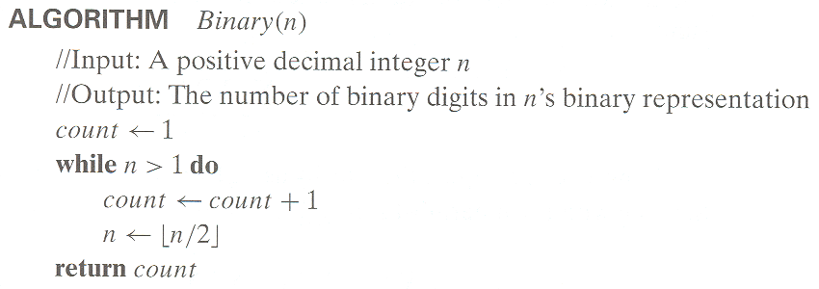
Example 5: Counting binary digits
It cannot be investigated the way the previous examples are.
A. Levitin “Introduction to the Design & Analysis of Algorithms,” 3rd ed., Ch. 2 ©2012 Pearson Education, Inc. Upper Saddle River, NJ. All Rights Reserved.

Slide 30
Plan for Analysis of Recursive Algorithms
Decide on a parameter indicating an input’s size.
Identify the algorithm’s basic operation.
Check whether the number of times the basic op. is executed may vary on different inputs of the same size. (If it may, the worst, average, and best cases must be investigated separately.)
Set up a recurrence relation with an appropriate initial condition expressing the number of times the basic op. is executed.
Solve the recurrence (or, at the very least, establish its solution’s order of growth) by backward substitutions or another method.
A. Levitin “Introduction to the Design & Analysis of Algorithms,” 3rd ed., Ch. 2 ©2012 Pearson Education, Inc. Upper Saddle River, NJ. All Rights Reserved.

Slide 31
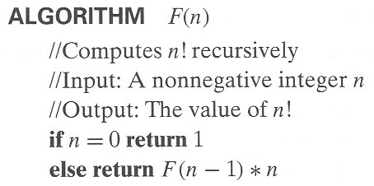
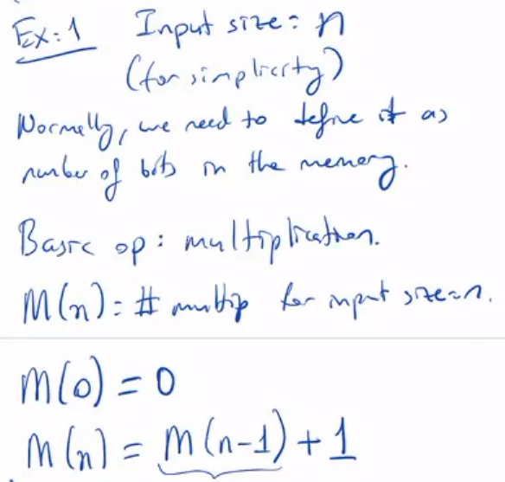
Example 1: Recursive evaluation of n!
Definition: n ! = 1 ⋅ 2 ⋅ … ⋅ (n-1) ⋅ n for n ≥ 1 and 0! = 1
Recursive definition of n!: F(n) = F(n-1) ⋅ n for n ≥ 1 and
F(0) = 1
Size:
Basic operation:
Recurrence relation:
A. Levitin “Introduction to the Design & Analysis of Algorithms,” 3rd ed., Ch. 2 ©2012 Pearson Education, Inc. Upper Saddle River, NJ. All Rights Reserved.
Notes:
Note the difference between the two recurrences. Students often confuse these!
F(n) = F(n-1) n
F(0) = 1
for the values of n!
------------
M(n) =M(n-1) + 1
M(0) = 0
for the number of multiplications made by this algorithm

Slide 32
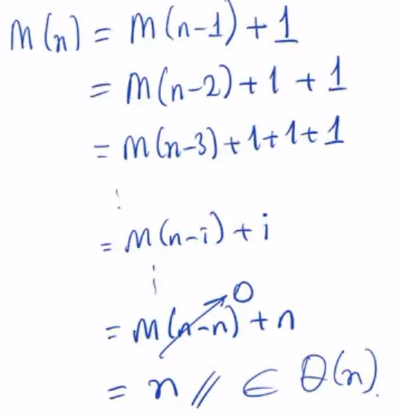
Solving the recurrence for M(n)
M(n) = M(n-1) + 1, M(0) = 0
A. Levitin “Introduction to the Design & Analysis of Algorithms,” 3rd ed., Ch. 2 ©2012 Pearson Education, Inc. Upper Saddle River, NJ. All Rights Reserved.

Slide 33
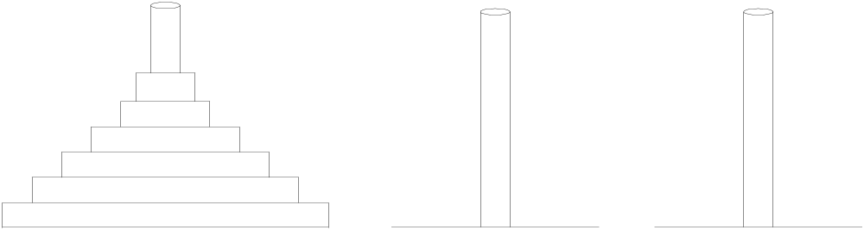
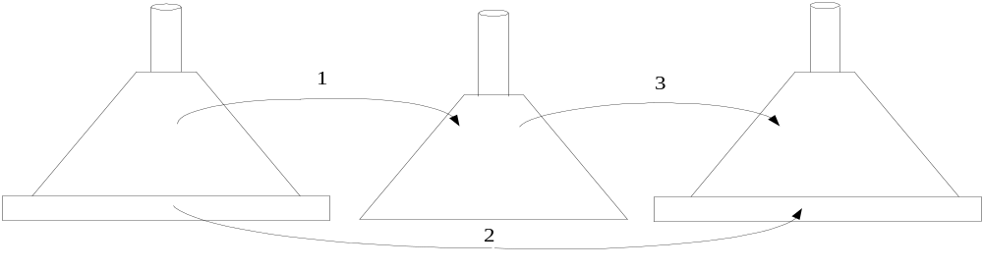
Example 2: The Tower of Hanoi Puzzle
Recurrence for number of moves:
A. Levitin “Introduction to the Design & Analysis of Algorithms,” 3rd ed., Ch. 2 ©2012 Pearson Education, Inc. Upper Saddle River, NJ. All Rights Reserved.

Slide 34
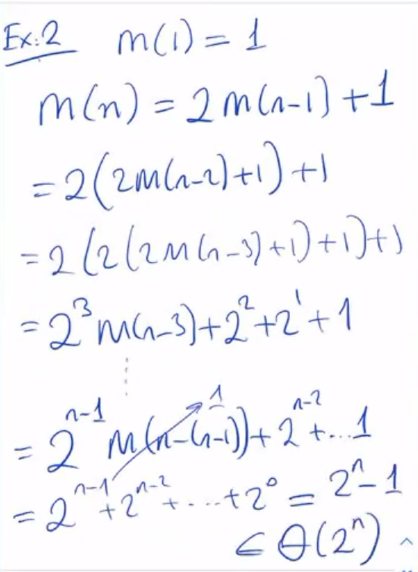
Solving recurrence for number of moves
M(n) = 2M(n-1) + 1, M(1) = 1
A. Levitin “Introduction to the Design & Analysis of Algorithms,” 3rd ed., Ch. 2 ©2012 Pearson Education, Inc. Upper Saddle River, NJ. All Rights Reserved.

Slide 35
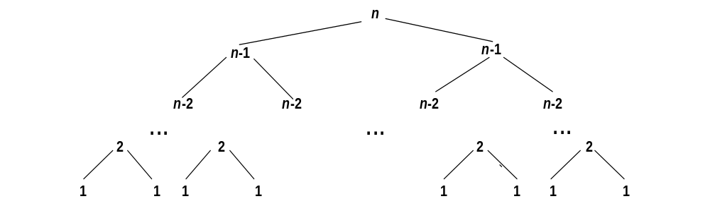
Tree of calls for the Tower of Hanoi Puzzle
A. Levitin “Introduction to the Design & Analysis of Algorithms,” 3rd ed., Ch. 2 ©2012 Pearson Education, Inc. Upper Saddle River, NJ. All Rights Reserved.

Slide 36
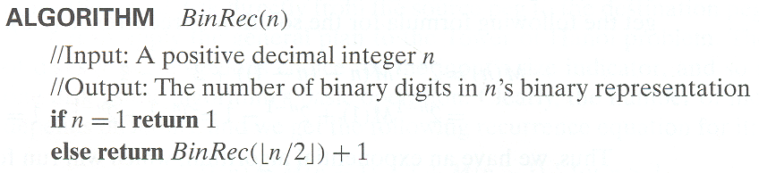
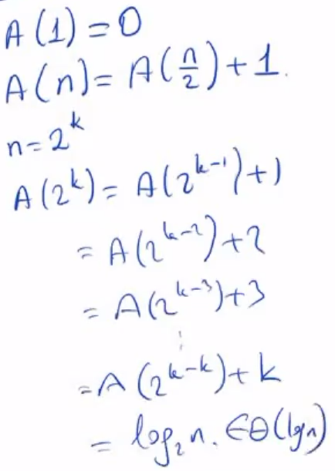
Example 3: Counting #bits
A. Levitin “Introduction to the Design & Analysis of Algorithms,” 3rd ed., Ch. 2 ©2012 Pearson Education, Inc. Upper Saddle River, NJ. All Rights Reserved.

Slide 37
Fibonacci numbers
The Fibonacci numbers:
  0, 1, 1, 2, 3, 5, 8, 13, 21, …
The Fibonacci recurrence:
  F(n) = F(n-1) + F(n-2)
  F(0) = 0
  F(1) = 1
General 2nd order linear homogeneous recurrence with
constant coefficients:
  aX(n) + bX(n-1) + cX(n-2) = 0
A. Levitin “Introduction to the Design & Analysis of Algorithms,” 3rd ed., Ch. 2 ©2012 Pearson Education, Inc. Upper Saddle River, NJ. All Rights Reserved.

Slide 38
Solving aX(n) + bX(n-1) + cX(n-2) = 0
Set up the characteristic equation (quadratic)
ar² + br + c = 0
Solve to obtain roots r₁ and r₂
General solution to the recurrence
  if r₁ and r₂ are two distinct real roots: X(n) = αr₁^{n} + βr₂^{n}
  if r₁ = r₂ = r are two equal real roots: X(n) = αr^{n} + βnr ^{n}
Particular solution can be found by using initial conditions
A. Levitin “Introduction to the Design & Analysis of Algorithms,” 3rd ed., Ch. 2 ©2012 Pearson Education, Inc. Upper Saddle River, NJ. All Rights Reserved.

Slide 39
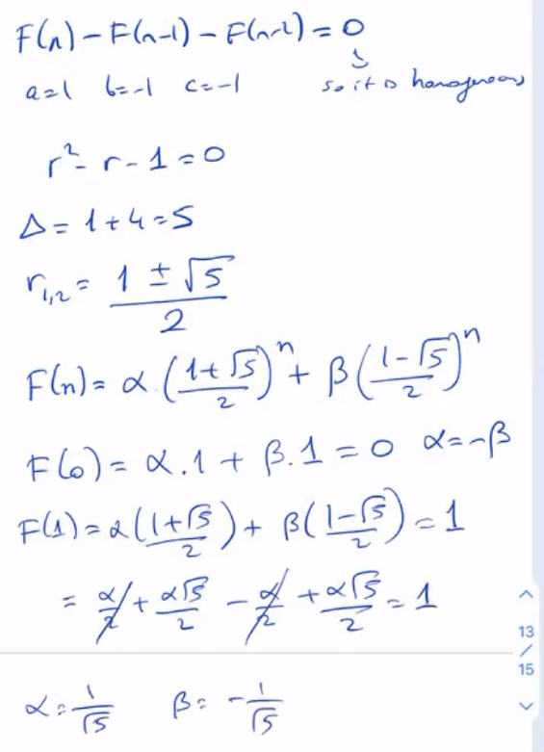
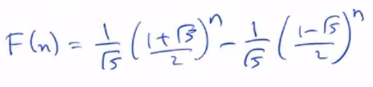
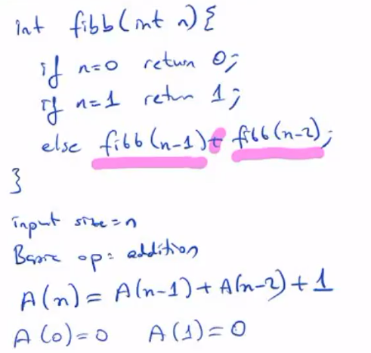
A. Levitin “Introduction to the Design & Analysis of Algorithms,” 3rd ed., Ch. 2 ©2012 Pearson Education, Inc. Upper Saddle River, NJ. All Rights Reserved.

Slide 40
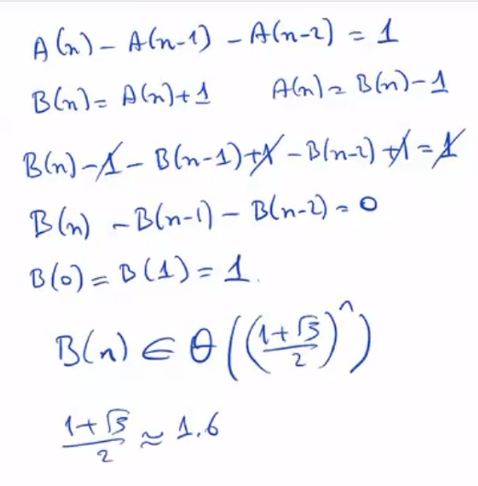
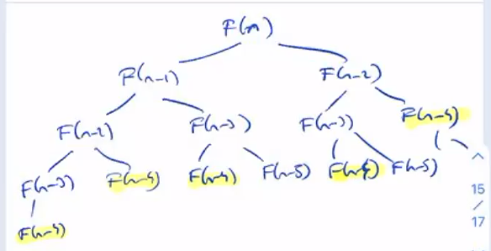
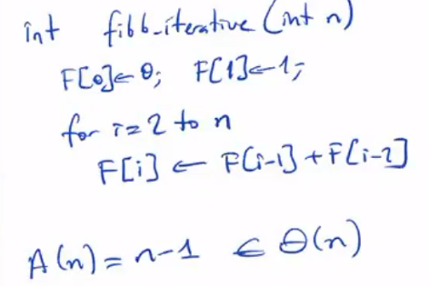
A. Levitin “Introduction to the Design & Analysis of Algorithms,” 3rd ed., Ch. 2 ©2012 Pearson Education, Inc. Upper Saddle River, NJ. All Rights Reserved.

Slide 41
Application to the Fibonacci numbers
F(n) = F(n-1) + F(n-2) or F(n) - F(n-1) - F(n-2) = 0
Characteristic equation:
Roots of the characteristic equation:
General solution to the recurrence:
Particular solution for F(0) =0, F(1)=1:
A. Levitin “Introduction to the Design & Analysis of Algorithms,” 3rd ed., Ch. 2 ©2012 Pearson Education, Inc. Upper Saddle River, NJ. All Rights Reserved.

Slide 42
Computing Fibonacci numbers
Definition-based recursive algorithm
Nonrecursive definition-based algorithm
Explicit formula algorithm
Logarithmic algorithm based on formula:
n
F(n-1) F(n)
0 1
=
F(n) F(n+1)
1 1
for n≥1, assuming an efficient way of computing matrix powers.
A. Levitin “Introduction to the Design & Analysis of Algorithms,” 3rd ed., Ch. 2 ©2012 Pearson Education, Inc. Upper Saddle River, NJ. All Rights Reserved.

Slide 43
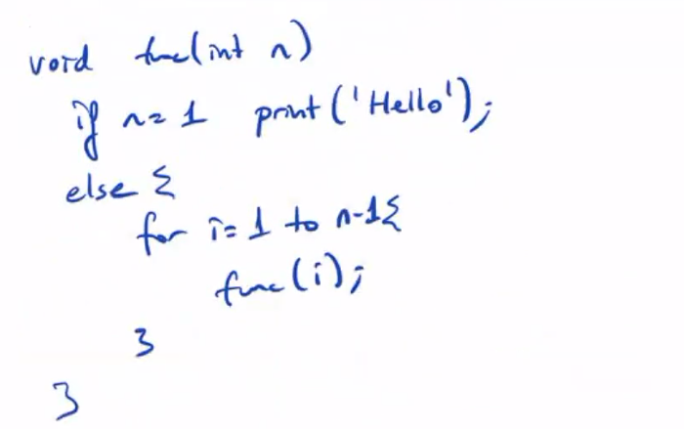
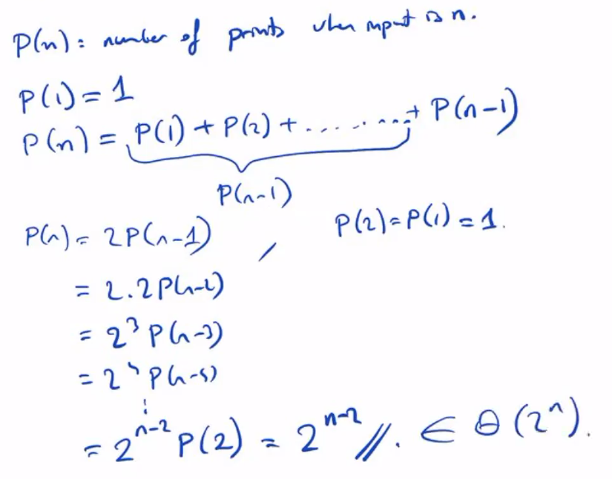
A. Levitin “Introduction to the Design & Analysis of Algorithms,” 3rd ed., Ch. 2 ©2012 Pearson Education, Inc. Upper Saddle River, NJ. All Rights Reserved.

Slide 44
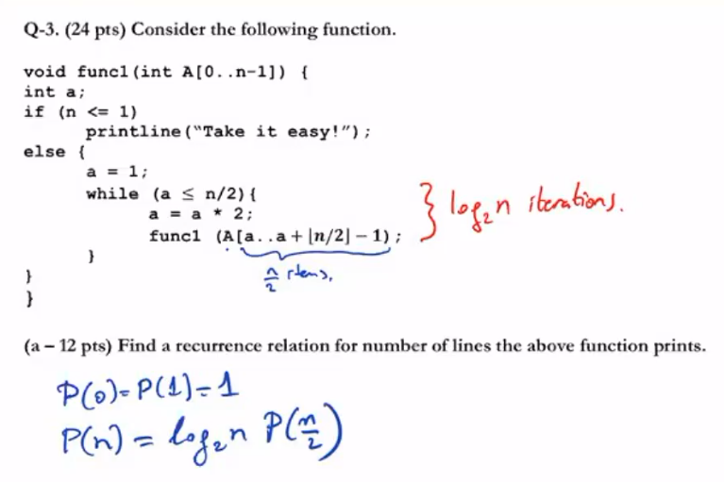
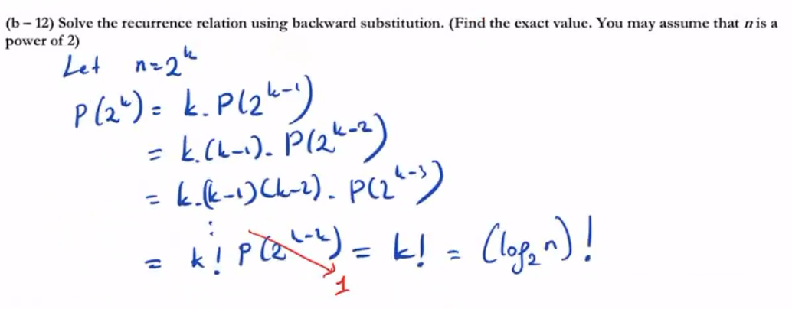
A. Levitin “Introduction to the Design & Analysis of Algorithms,” 3rd ed., Ch. 2 ©2012 Pearson Education, Inc. Upper Saddle River, NJ. All Rights Reserved.

